Slide 1
E-Commerce Site
E-commerce Pitch Deck

Slide 2
IntRoDUCtion
Best E-commerce site for your business for increased sales, customer attraction and retention

Slide 3
Problems
Low Engagement
Low Sales
Categorize products

Slide 4
Solutions
Better images and text
Better product presentation and instinctive UI
Better search and filter features

Slide 5
Benefits
Increase peak of interest and engagement
Customer retention
More sales from ease of use and availability

Slide 6
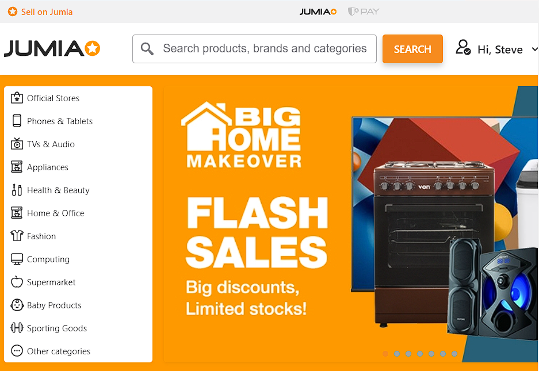
Images
Search and filters
Categories
Engaging images

